Slide 1
LECTURE ONE
INTRODUCTION TO COST CONCEPTS
© 2020 McGraw-Hill Education. All rights reserved. Authorized only for instructor use in the classroom. No reproduction or further distribution permitted without the prior written consent of McGraw-Hill Education.
Notes:
Chapter 6: Cost-Volume-Profit Analysis
Cost-volume-profit (CVP) analysis is a decision-making tool that focuses on the relationship among the volume and mix of units sold, prices, variable costs, fixed costs, and profit. The CVP framework allows managers to evaluate how changing one or more of these key variables will impact profitability, while holding everything else constant.

Slide 2

Purpose of Managerial Accounting
Exhibit 18.1
Planning
Develop new products?
Expand into new markets?
Build a new factory?
Control
Are costs too high?
Are services profitable?
Are customers satisfied?
Learning Objective C1: Explain the purpose and nature of, and the role of ethics in, managerial accounting.
Notes:
The purpose of managerial accounting is to provide useful information to aid in three key managerial tasks:
determining the costs of an organization’s products and services
planning future activities
comparing actual results to planned results
Planning is the process of setting goals and making plans to achieve them. Long-term strategic plans usually span a 5-10 year horizon.
Control is the process of monitoring planning decisions and evaluating an organization’s activities and employees. Feedback provided by the control function allows managers to revise their plans.

Slide 3
Topics to be Discussed
Financial Reporting
Planning
Cost-Volume-Profit Analysis and Budgeting
Assigning Costs to Cost Objects
Making Business Decisions
Notes:
We have looked at the cost classifications used for financial reporting, predicting cost behavior, assigning costs to cost objects, and making business decisions. Now, let’s look at how to classify idle time, overtime, and fringe benefits.

Slide 4
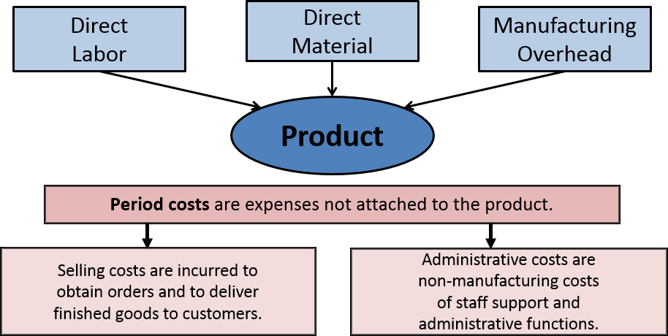
Cost Classifications for Financial Reporting Product Vs Period Costs
Access the text alternative for slide images.
Learning Objective C3: Define product and period costs and explain how they impact financial statements.
Notes:
All production (or factory) costs are product costs. Product costs are those production costs necessary to create a product and consist of: direct materials, direct labor, and factory overhead. Overhead refers to production costs other than direct materials and direct labor. Product costs are capitalized as inventory during and after completion of the products; they become cost of goods sold when those products are sold.
Period costs are non-production costs and are usually more associated with activities linked to a time period than with completed products. Common examples of period costs include salaries of the sales staff, wages of maintenance workers, advertising expenses, and depreciation on office furniture and equipment. Period costs and are expensed in the period when incurred either as selling expenses or as general and administrative expenses.

Slide 5
Direct Material
Major material inputs that can be physically and conveniently traced directly to the final product.
Examples:
Glass windows installed in an automobile
Sauce, cheese, and meat for a pizza
Notes:
Direct materials are an integral part of the finished product and can be physically and conveniently traced to it. For a frozen pizza manufacturer, direct materials include the major ingredients (e.g., dough, sauce, cheese, and meat), as well as packaging materials (e.g., plastic and cardboard).

Slide 6
Direct Labor
Is the cost of labor that can be physically and conveniently traced to the final product.
Examples:
Wages paid to automobile assembly workers
Wages paid to employees on the pizza production line
Notes:
Direct labor consists of that portion of labor cost that can be easily traced to a product. Direct labor is sometimes referred to as “touch labor” since it consists of the costs of workers who “touch” the product as it is being made. Examples include the wages of employees on the pizza production line and in the packaging department.

Slide 7
Manufacturing Overhead
Includes all costs other than direct materials and direct labor that must be incurred to manufacture a product.
Manufacturing overhead costs include the following costs at the manufacturing facility: maintenance and repairs on production equipment, utilities, property taxes, depreciation, insurance, and salaries for supervisors, janitors, and security guards.
Notes:
Manufacturing overhead includes all manufacturing costs except direct materials and direct labor. These costs cannot be easily traced to specific units produced.
Examples of manufacturing overhead costs include maintenance and repairs on production equipment, utilities, property taxes, depreciation, insurance, and salaries for supervisors, janitors, and security guards at the manufacturing facility.

Slide 8
Period Costs (Non manufacturing Costs)
Marketing or Selling Costs
Costs necessary to get the order and deliver the product
General and Administrative Costs
All executive, organizational, and clerical costs
Not part of Factory Overhead because they are not incurred in manufacturing products.
Notes:
A manufacturing company incurs many other costs in addition to manufacturing costs. Nonmanufacturing costs are those costs associated with running the business and selling the product, as opposed to manufacturing the product.
Selling costs include all costs necessary to secure customer orders and get the finished product into the hands of the customer. These costs are also referred to as order-getting and order-filling costs.
Administrative costs include all executive, organizational, and clerical costs associated with the general management of an organization that are not classified as production or marketing costs.

Slide 9
Quick Check ✓
Which of the following costs would be considered a period rather than a product cost in a manufacturing company?
A. Manufacturing equipment depreciation.
B. Property taxes on corporate headquarters.
C. Direct materials costs.
D. Electrical costs to light the production
facility.
E. Sales commissions.
Notes:
Which of the following costs would be considered a period rather than a product cost in a manufacturing company?

Slide 10
Quick Check ✓
Which of the following costs would be considered a period rather than a product cost in a manufacturing company?
A. Manufacturing equipment depreciation.
B. Property taxes on corporate headquarters.
C. Direct materials costs.
D. Electrical costs to light the production
facility.
E. Sales commissions.
Notes:
Property taxes on corporate headquarters and sales commissions are period costs. All of the other costs listed are product costs.

Slide 11
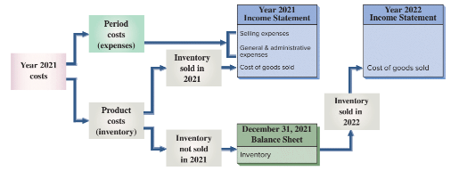
Reporting Product and Period Costs in Financial Statements
Learning Objective C2: Describe accounting concepts useful in classifying costs.
Access the text alternative for slide images.
Notes:
Period costs go directly to the current income statement as expenses. They are not reported as assets.
Product costs are first assigned to inventory. Their final treatment depends on when inventory is sold. Product costs assigned to inventory that is sold in 2021 are reported on the 2021 income statement as cost of goods sold. Product costs assigned to unsold inventory are reported on the 2021 balance sheet. If this inventory is sold in 2022, product costs assigned to it are reported as cost of goods sold in the 2022 income statement.

Slide 12
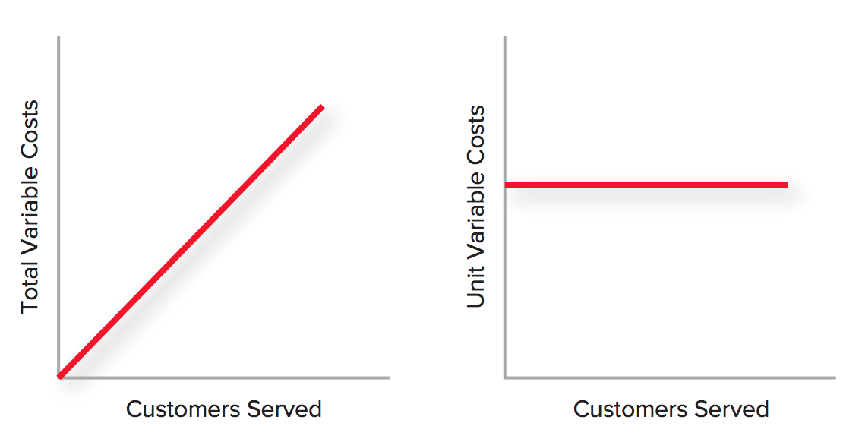
Cost Classifications For Predicting Cost Behavior
1- Variable Costs: Change, in total, in direct proportion to changes in activity level.
Variable Cost Behavior
Access the text alternative for slide images
Notes:
Managers often need to be able to predict how costs will change in response to changes in activity. The activity might be the output of goods or services or it might be some measure of activity internal to the company, such as the number of purchase orders processed during a period.
The most commonly used classifications of cost behavior are variable and fixed costs. Total variable costs increase as activity increases. For example, your total gasoline cost (total amount of gallons used) increases as you drive more miles in your car, but the cost per gallon remains the same.

Slide 13
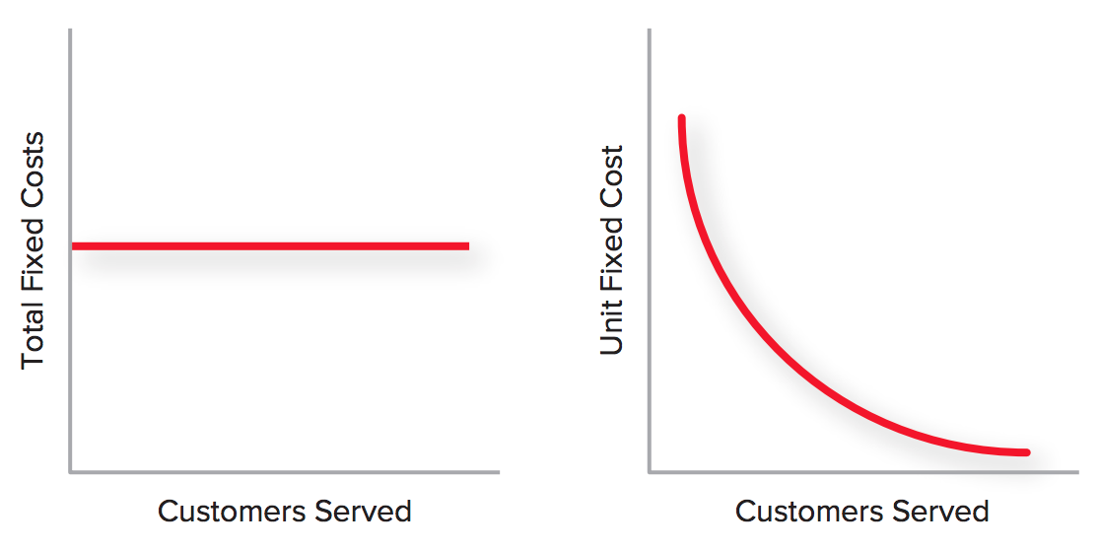
2-Fixed costs do not change in total, regardless of the activity level, at least within some reasonable range of activity. Average or per-unit fixed costs vary inversely with the number of units produced or the number of customers served.
Access the text alternative for slide images
Notes:
Fixed costs are those costs that stay the same, in total, regardless of activity level. Although total fixed costs are constant, average or per-unit fixed costs vary inversely with the number of units produced or the number of customers served. That is because spreading a constant amount over more units or customers drives down the average cost.

Slide 14
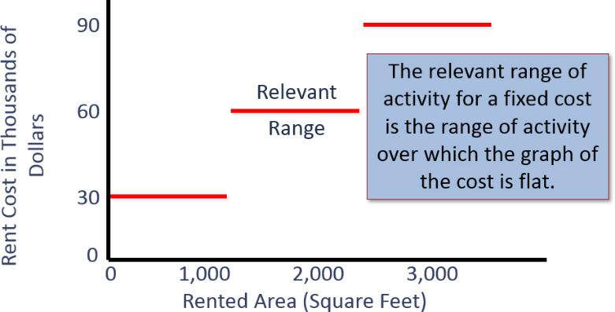
Relevant Range: Graphic
Access the text alternative for slide images.

Slide 15
Comparison of Cost Classifications for Predicting Cost Behavior
Behavior of Cost (within the relevant range)
Cost | In Total | Per Unit
Variable | Total variable costs increase and decrease in proportion to changes in the activity level. | Variable cost per unit remains constant.
Fixed | Total fixed cost is not affected by changes in the activity level within the relevant range. | Fixed cost per unit decreases as the activity level rises and increases as the activity level falls.

Slide 16
Quick Check 2
Which of the following costs would be variable with respect to the number of ice cream cones sold at a Baskin & Robbins? (There may be more than one correct answer.)
A. The cost of lighting the store.
B. The wages of the store manager.
C. The cost of ice cream.
D. The cost of napkins for customers.

Slide 17
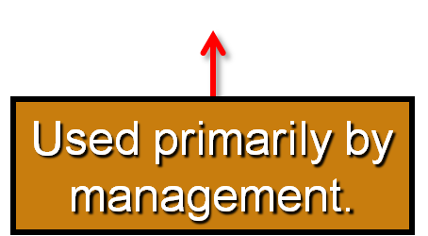
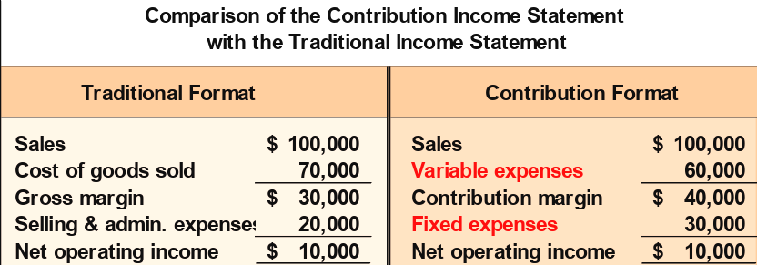
The Traditional and Contribution Formats
Used primarily for external reporting.
Notes:
The contribution format allocates costs based on cost behavior. The contribution approach differs from the traditional approach illustrated in an earlier chapter.
The traditional approach organizes costs in a functional format. Costs relating to production, administration, and sales are grouped together without regard to their cost behavior.
The traditional approach is used primarily for external reporting purposes.

